Slide 1
Lists

Slide 2
Lists
There are four collection data types in Python :
List: is a collection which is ordered and changeable(modifiable). Allows duplicate members.
Tuple: is a collection which is ordered and unchangeable or unmodifiable(immutable). Allows duplicate members.
Set: is a collection which is unordered, un-indexed and unmodifiable, but we can add new items to the set. Duplicate members are not allowed.
Dictionary: is a collection which is unordered, changeable(modifiable) and indexed. No duplicate members.
A list is collection of different data types which is ordered and modifiable(mutable). A list can be empty or it may have different data type items.

Slide 3
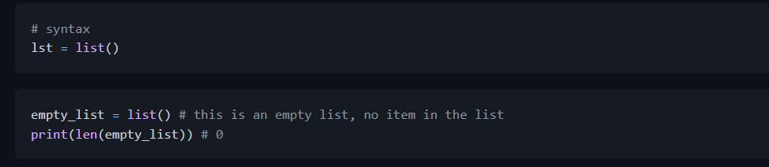
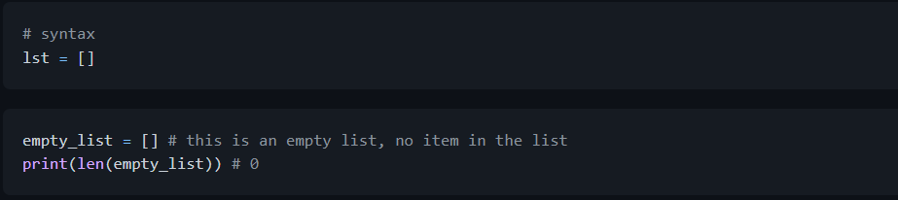
How to Create a List
In Python we can create lists in two ways:
Using list built-in function
Using square brackets, []

Slide 4




Task:

Slide 5
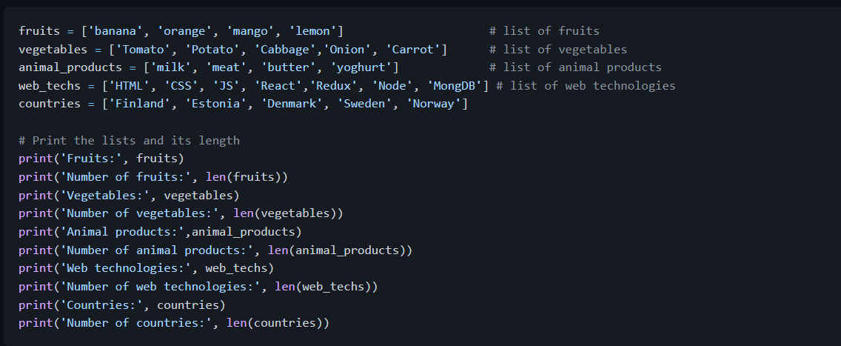
Lists with initial values. We use len() to find the length of a list.
Find Outputs for the given example.

Slide 6
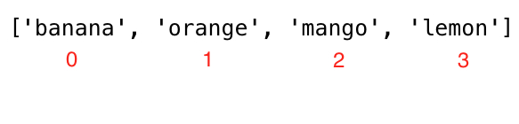
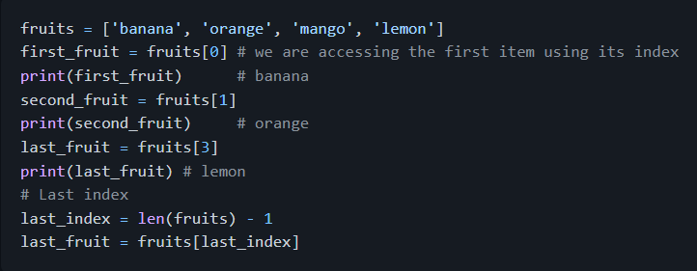
Lists can have items of different data types
Accessing List Items Using Positive Indexing:
We access each item in a list using their index. A list index starts from 0. The picture below shows clearly where the index starts

Slide 7
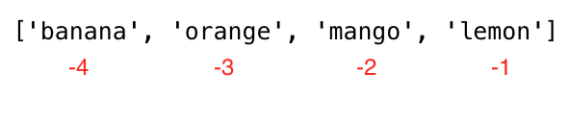
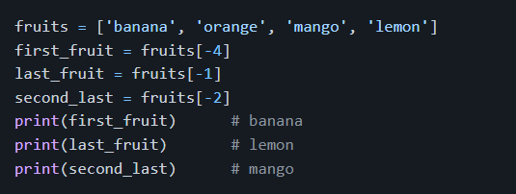
Accessing List Items Using Negative Indexing
Negative indexing means beginning from the end, -1 refers to the last item, -2 refers to the second last item.

Slide 8
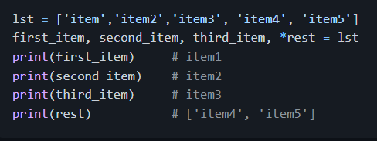
Unpacking List Items

Slide 9
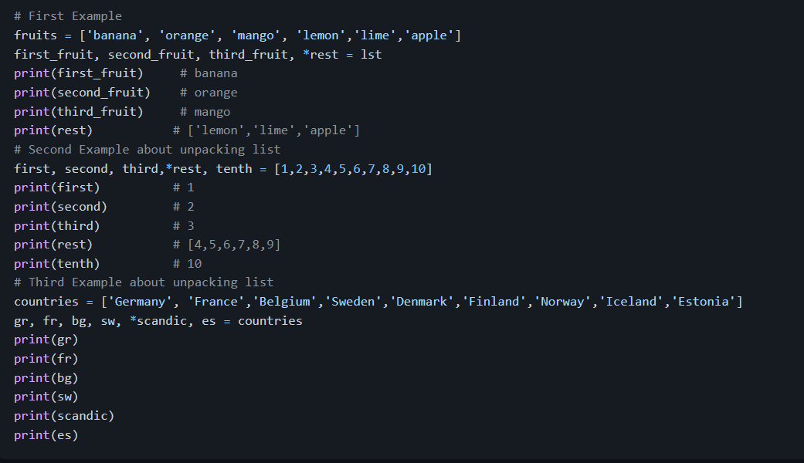

Slide 10
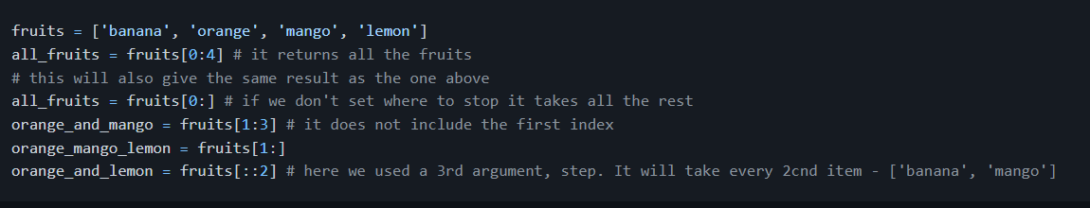
Slicing Items from a List
Positive Indexing: We can specify a range of positive indexes by specifying the start, end and step, the return value will be a new list. (default values for start = 0, end = len(lst) - 1 (last item), step = 1)

Slide 11
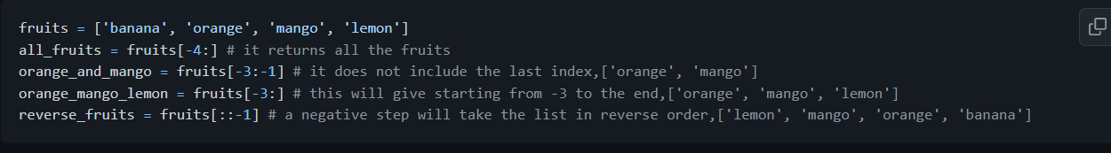
Negative Indexing: We can specify a range of negative indexes by specifying the start, end and step, the return value will be a new list.

Slide 12
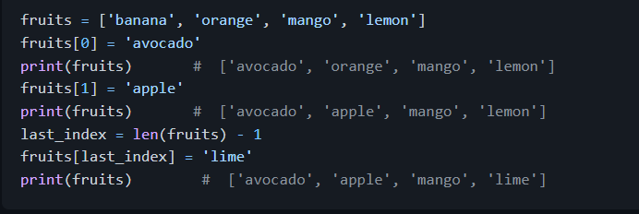
Modifying Lists
List is a mutable or modifiable ordered collection of items. Lets modify the fruit list.

Slide 13
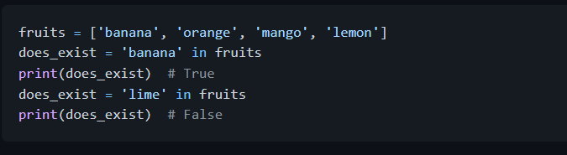
Checking Items in a List
Checking an item if it is a member of a list using in operator. See the example below.

Slide 14
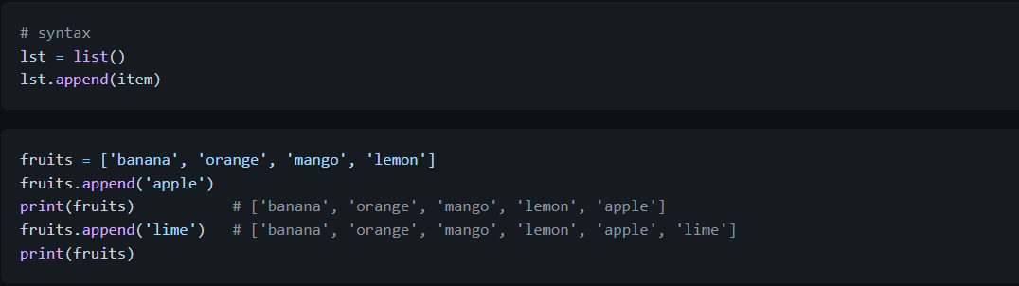
Adding Items to a List
To add item to the end of an existing list we use the method append().

Slide 15
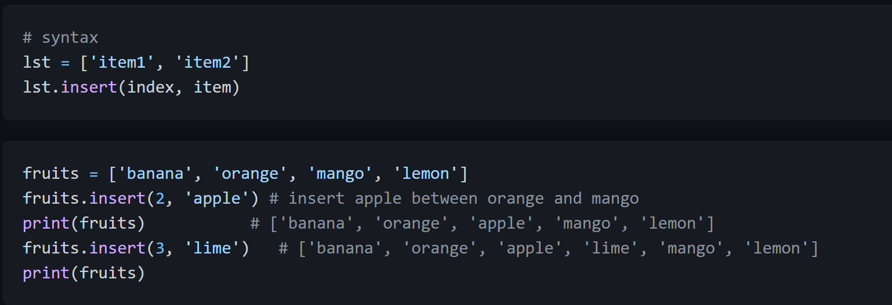
Inserting Items into a List
We can use insert() method to insert a single item at a specified index in a list. Note that other items are shifted to the right. The insert() methods takes two arguments:index and an item to insert.

Slide 16
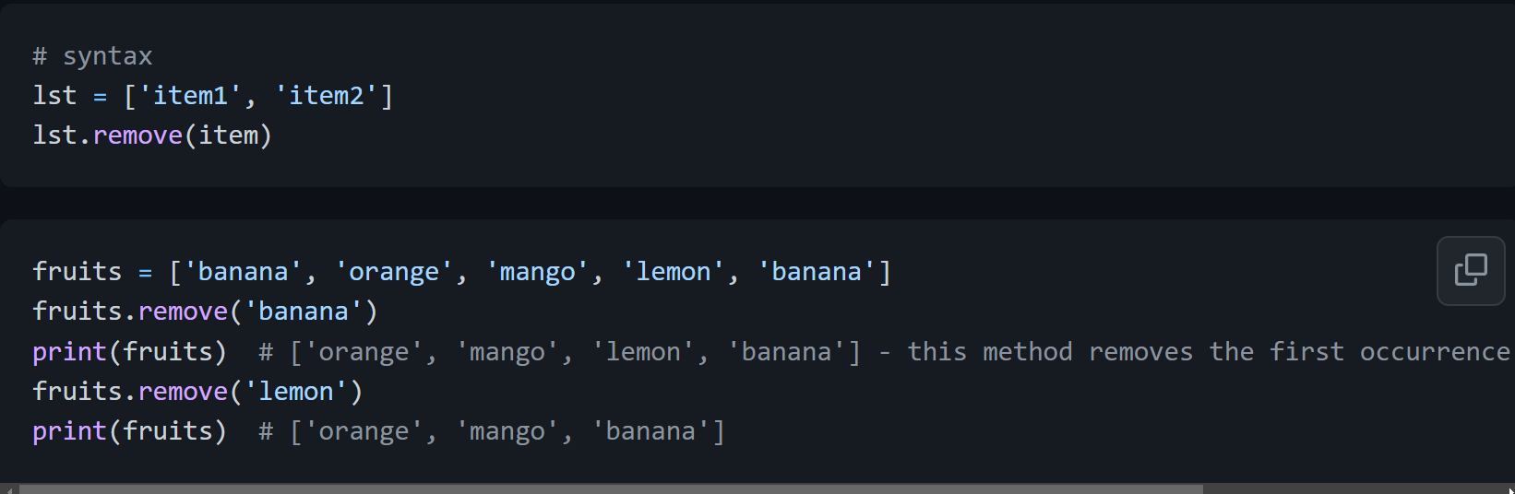
Removing Items from a List
The remove method removes a specified item from a list

Slide 17
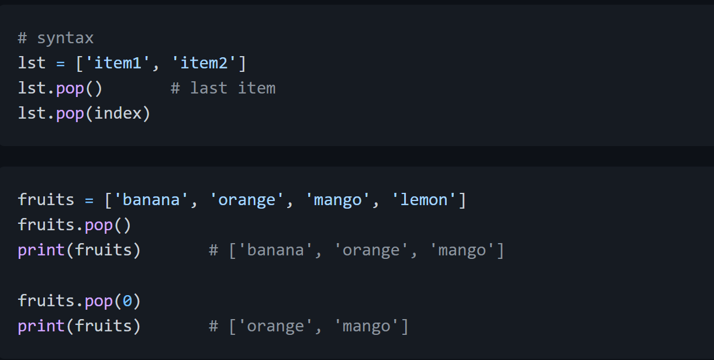
Removing Items Using Pop
The pop() method removes the specified index, (or the last item if index is not specified):

Slide 18
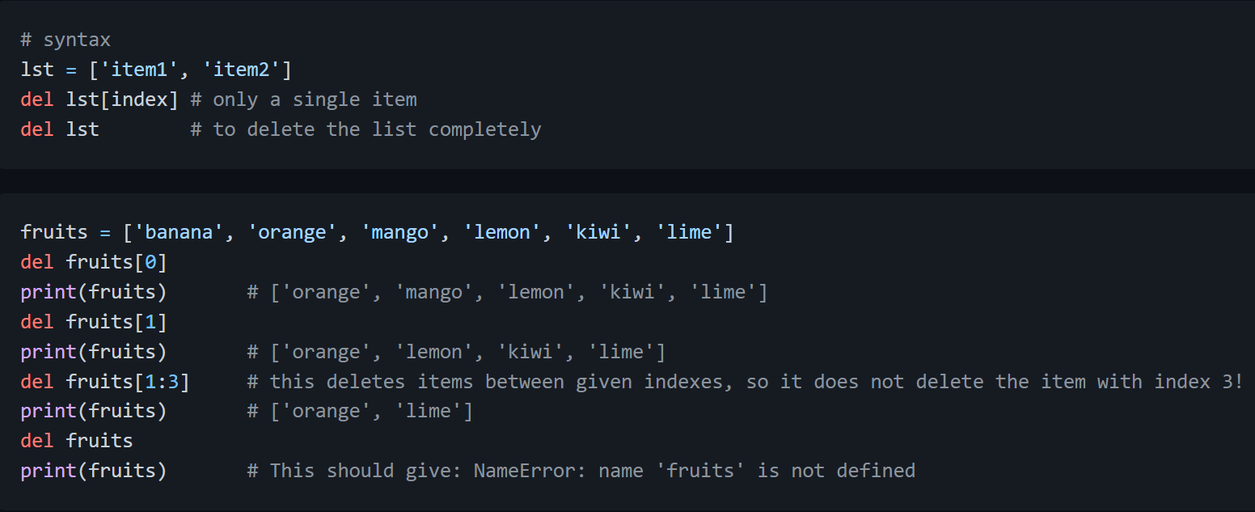
Removing Items Using Del
The del keyword removes the specified index and it can also be used to delete items within index range. It can also delete the list completely

Slide 19
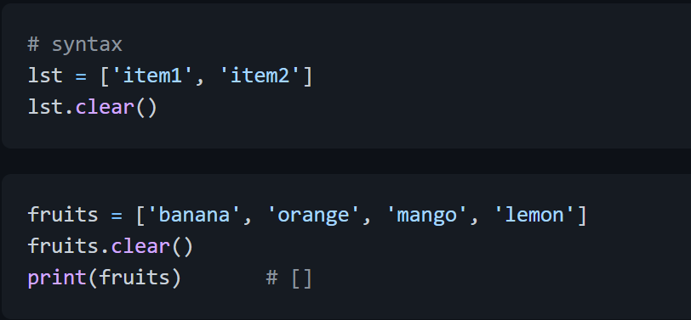
Clearing List Items
The clear() method empties the list:

Slide 20
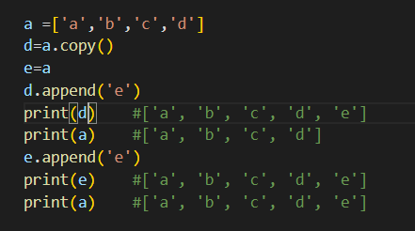
Copying a List
It is possible to copy a list by reassigning it to a new variable in the following way: list2 = list1. Now, list2 is a reference of list1, any changes we make in list2 will also modify the original, list2. But there are lots of case in which we do not like to modify the original instead we like to have a different copy. One of way of avoiding the problem above is using copy().

Slide 21
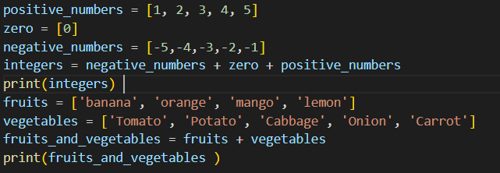
Joining Lists
There are several ways to join, or concatenate, two or more lists in Python.
Plus Operator (+)

Slide 22
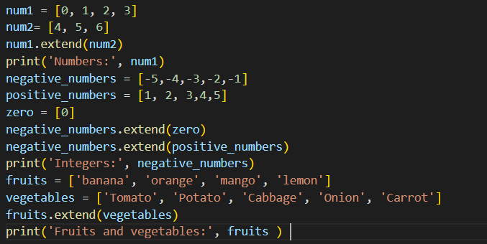
Joining using extend() method The extend() method allows to append list in a list. See the example below.

Slide 23
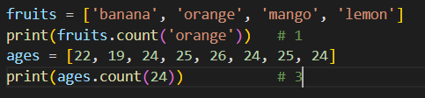
Counting Items in a List
The count() method returns the number of times an item appears in a list:

Slide 24
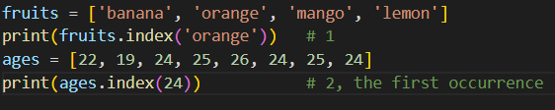
Finding Index of an Item
The index() method returns the index of an item in the list:

Slide 25
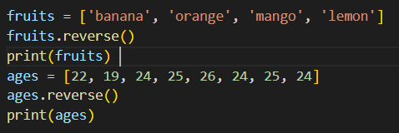

Reversing a List
The reverse() method reverses the order of a list.
O/p:-

Slide 26
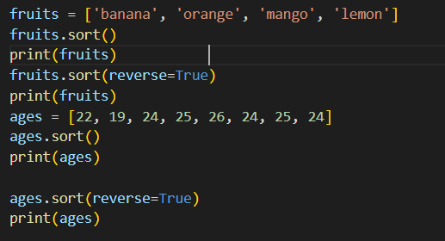

Sorting List Items
To sort lists we can use sort() method or sorted() built-in functions. The sort() method reorders the list items in ascending order and modifies the original list. If an argument of sort() method reverse is equal to true, it will arrange the list in descending order.
sort(): this method modifies the original list
O/P:-

Slide 27
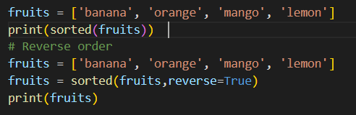

sorted(): returns the ordered list without modifying the original list Example:
O/P:-

Slide 28
Exercises: Day 5
Exercises: Level 1
Declare an empty list
Declare a list with more than 5 items
Find the length of your list
Get the first item, the middle item and the last item of the list
Declare a list called mixed_data_types, put your(name, age, height, marital status, address)
Declare a list variable named it_companies and assign initial values Facebook, Google, Microsoft, Apple, IBM, Oracle and Amazon.

Slide 29
Print the list using print()
Print the number of companies in the list
Print the first, middle and last company
Print the list after modifying one of the companies
Add an IT company to it_companies
Insert an IT company in the middle of the companies list
Change one of the it_companies names to uppercase (IBM excluded!)
Join the it_companies with a string '#; '
Check if a certain company exists in the it_companies list.
Sort the list using sort() method

Slide 30
Reverse the list in descending order using reverse() method
Slice out the first 3 companies from the list
Slice out the last 3 companies from the list
Slice out the middle IT company or companies from the list
Remove the first IT company from the list
Remove the middle IT company or companies from the list
Remove the last IT company from the list
Remove all IT companies from the list
Destroy the IT companies list

Slide 31
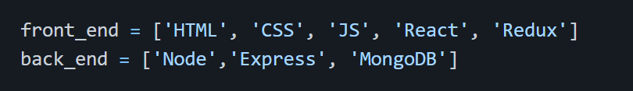
Join the following lists:
After joining the lists in question 26. Copy the joined list and assign it to a variable full_stack. Then insert Python and SQL after Redux.

Slide 32

Exercises: Level 2
The following is a list of 10 students ages:
Sort the list and find the min and max age
Add the min age and the max age again to the list
Find the median age (one middle item or two middle items divided by two)
Find the average age (sum of all items divided by their number )
Find the range of the ages (max minus min)
Compare the value of (min - average) and (max - average), use abs() method

